Slide 2
Evil Twin Attack Disclaimer
https://www.linkedin.com/company/wocsa/ https://www.youtube.com/@WOCSA-rx2mn/
Disclaimer
The following demonstration is for educational purposes only.
We do not promote or encourage illegal activities.
Knowing your enemy is a half-won battle
La connaissance n'est réellement profitable que lorsqu'elle est partagée
https://github.com/wocsa

Slide 3

Evil Twin Attack Agenda
https://www.linkedin.com/company/wocsa/ https://www.youtube.com/@WOCSA-rx2mn/
What is an Evil Twin Attack?
Forcing users onto a phishing portal
How to create your own Evil Portal
How to protect against it
https://github.com/wocsa

Slide 4
What is an Evil Twin Attack?
13/03/2026

Slide 5
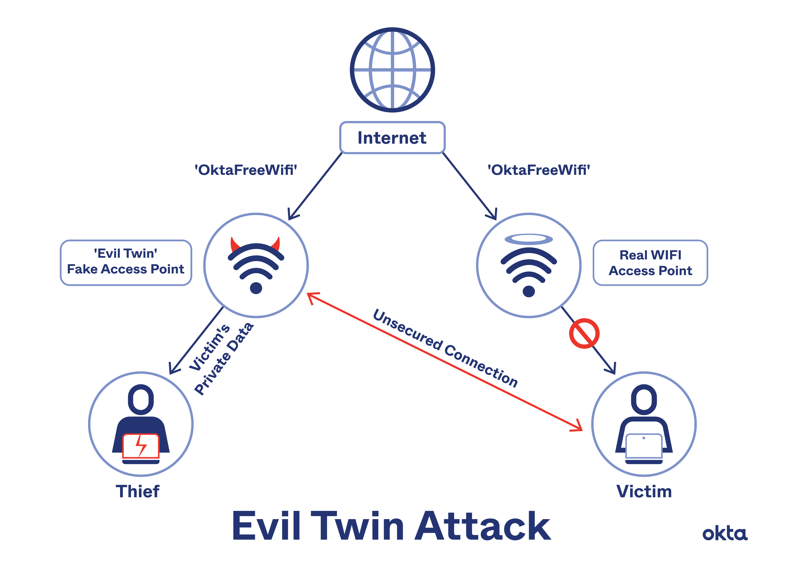
Evil Twin Attack What is an Evil Twin Attack?
https://www.linkedin.com/company/wocsa/ https://www.youtube.com/@WOCSA-rx2mn/
A kind of Man-In-The-Middle (MITM) attack
Use to steal passwords and monitoring traffic
A fake wireless access point that has a similar SSID to the legitimate access point.
https://github.com/wocsa

Slide 6
Forcing users onto a phishing portal
13/03/2026

Slide 7
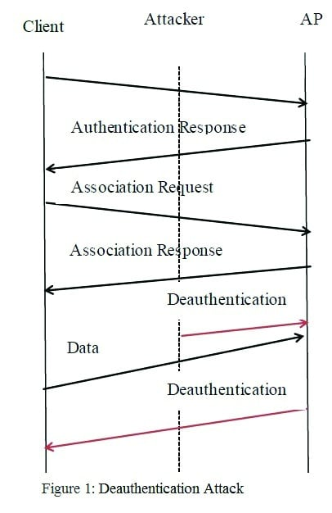
Evil Twin Attack Forcing users onto a phishing portal
https://www.linkedin.com/company/wocsa/ https://www.youtube.com/@WOCSA-rx2mn/
Denial of service attack
Deauth attack
WiFi Jamming
https://github.com/wocsa

Slide 8
How to create your own Evil Portal
13/03/2026

Slide 9
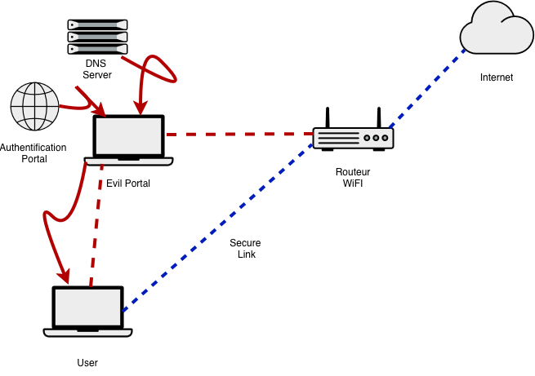
Evil Twin Attack How to create your own Evil Portal?
https://www.linkedin.com/company/wocsa/ https://www.youtube.com/@WOCSA-rx2mn/
Hostapd
Dnsmasq
Iptables
https://github.com/wocsa

Slide 10
How to protect against it?
13/03/2026

Slide 11
Wi-Fi Captive Portal How to protect a Captive Portal?
https://www.linkedin.com/company/wocsa/ https://www.youtube.com/@WOCSA-rx2mn/
Block all incoming connections and allow HTTPS to your router before granted user permissions
Choose carefully which public Wi-Fi you want to connect and use a VPN
https://github.com/wocsa

Slide 12







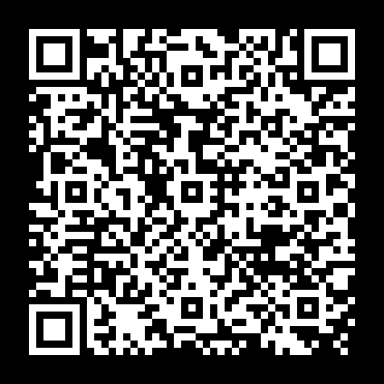


Join us to change the digital world: https://www.helloasso.com/associations/wocsa/adhesions/bulletin-d-adhesion-2 Please provide your feedback for our quality check process: https://www.wocsa.org/qcheck.php
13/03/2026
www.wocsa.org
@wocsa
@wocsa_asso
@wocsa
contact@wocsa.org
Join Us!
@WOCSA-rx2mn
https://discord.gg/pDunje3tpb

